Slide 1
ALMA MATER STUDIORUM - UNIVERSITÀ DI BOLOGNA School of Engineering and Architecture Department of Electrical, Electronics and Information Engineering - DEI Master Thesis In Automation Engineering Finding Objects in Images by Line Segments
Candidate: Supervisor: Majid Mazaheri Prof. L. Di Stefano

Slide 2
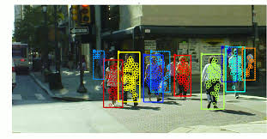
Computer vision
Nowadays it has a big role in many applications such as industry ,robots ,auto drive cars ,...

Slide 3
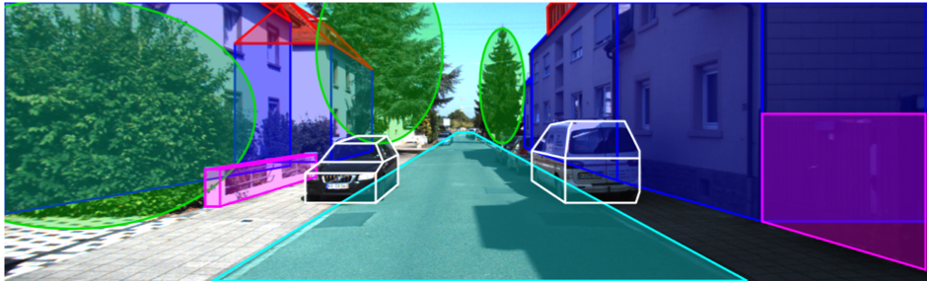
Finding Objects in Images
One of main tasks of computer vision is to recognize particular objects in images

Slide 4
Proposed method,object types
To pursue recognition of well defined as we have said previously and porely textured objects i hacve combined 2 well known techniks in computer vision
1 – Hough Transform
1-1 Generalized Hough Transform
2 –LSD , Finding Line segments
Notes:
My thesis is also about recognizing object in images with particular emphasis on the kind of objects that are typically found in industrial applications (original pic of my work)this kind of objects have a well defined shape unlike people animals ,cars , and they are poorely textured which means that most of information that required to detect objects are associated with the counter of object(add also picture of human in different position)

Slide 5
Overview of Hough Transform
The Hough Transform is a Object detection technique used in image analysis, computer vision, and digital image processing.
The classical Hough transform was used for identification of lines in the image
later the Hough transform has been extended to identifying positions of arbitrary shapes (Generalized Hough Transform)
D.H. Ballard, "Generalizing the Hough Transform to Detect Arbitrary Shapes", Pattern Recognition, Vol.13, No.2, p.111-122, 1981

Slide 6
Generalized Hough Transform
Offline phase(work on sample image)
1.A reference point y is chosen (e.g. barycentre).
2.For each point x belonging to object’s border B:
3.Compute gradient direction φ(x)
4.Compute vector r from x to y (i.e. r = y-x ).
5.Store r as a function of Δφ (R-Table)
Notes:
(just to say : this table is actually our object model which we rely upon to detect object)

Slide 7
Generalized Hough Transform
Online phase(work on target image)
1-An image A[y] is initialized as accumulator array.
For each edge pixel x of the target image :
2-Compute gradient direction φ(quantization the same
As before)
3- Quantize φ to index the R-Table.
For each ri vector stored into the accessed row:
a)Compute the position the reference point y: y=x + ri
b)Cast a vote into the accumulator array: A[y]++(we increment a counter)
4-Instances of the sought object are detected by finding peaks of the accumulator array.
As u see here we deal always with edge pixels while our idea in this work is to work on line segments rather than edge pixels (just say so because of that we need a line segment detect the

Slide 8
Line Segment Detector(LSD )
As nowaday the most effective way of finding lines segment in images is LSD
It is a method to find line segments in images
It is published by Mr Rafael Grompone von Gioi1 in 2012
Comparing to before methods for finding line segments it is much more faster and accurate
Put picture of edge and line and compare

Slide 9
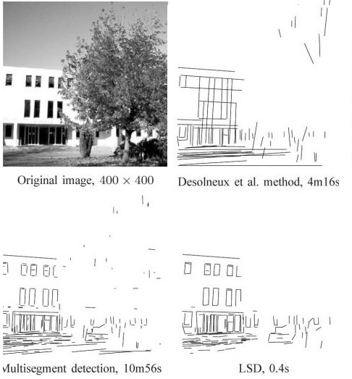
Comparison between LSD and other methods

Slide 10
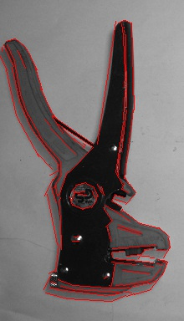
Combining LSD with Generalized Hough Transform
Find Lines Segments of sample by LSD
Notes:
Title :proposed method

Slide 11
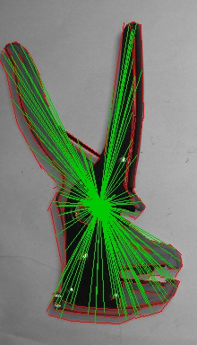
Offline phase _Make r-table
Take refrence point (e.g barycenter)
Compute lines angles φ(x)
Make r vector from each line segment to ref point
Store r as a function of Δφ (R-Table)
Green lines are r vectores
Δφ | R
Δφ1 | r1,r2,…
Δφ2 | r3,r4,r5,…
Δφ… | ….
Notes:
Proposed method

Slide 12
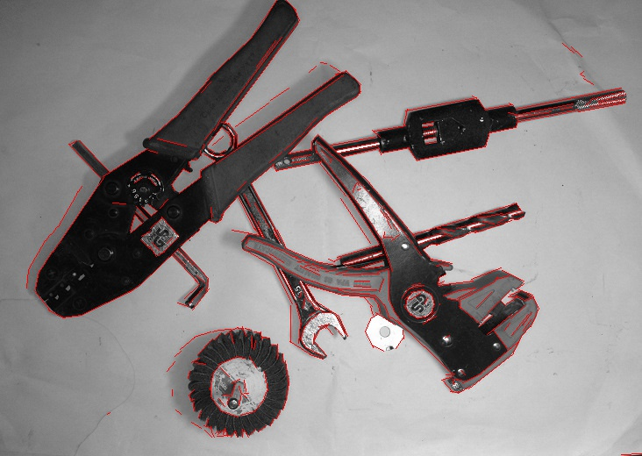
Find Lines by LSD on Main image
Notes:
Sample image and target image not main image(title proposed method)

Slide 13
Online phase
1-An image A[y] is initialized as accumulator array.
For each line segment of main image :
2-Compute angle φ
3- Quantize φ to index the R-Table. And add all corresponding r vectors
For each r_{i} vector added to line segment:
a)Compute the position of reference point y: y=x + r_{i}
b)Cast a vote into the accumulator array: A[y]++
4-Instances of the sought object are detected by finding peaks of the accumulator array.
Notes:
Proposed method

Slide 15
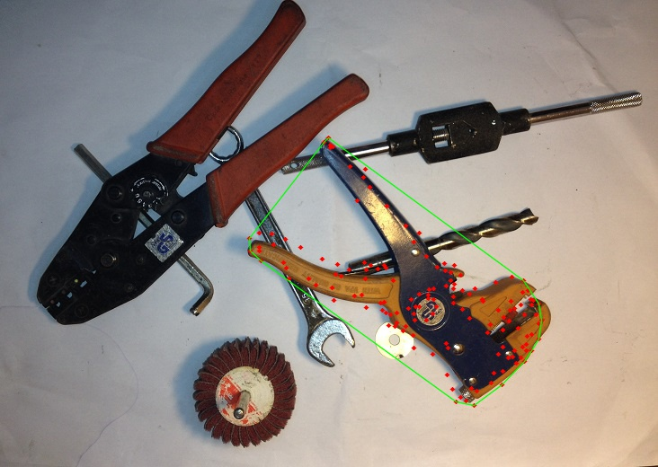
Notes:
Experimental results

Slide 16
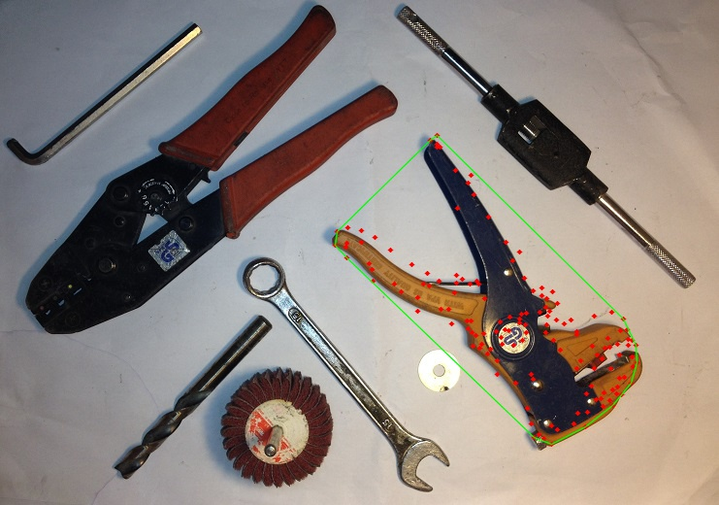

Slide 17
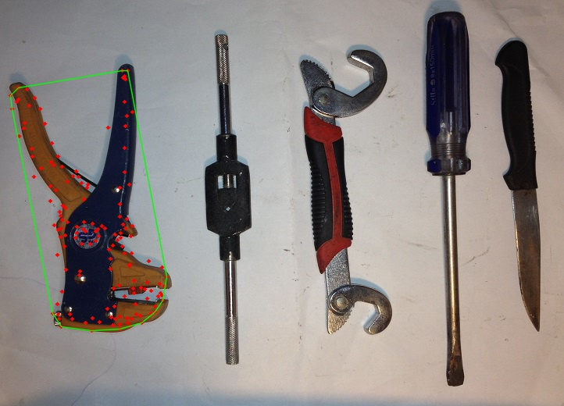

Slide 18
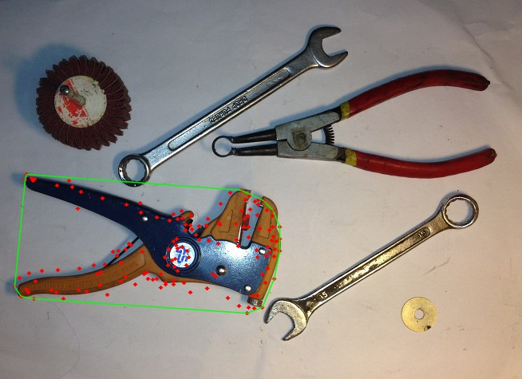

Slide 19
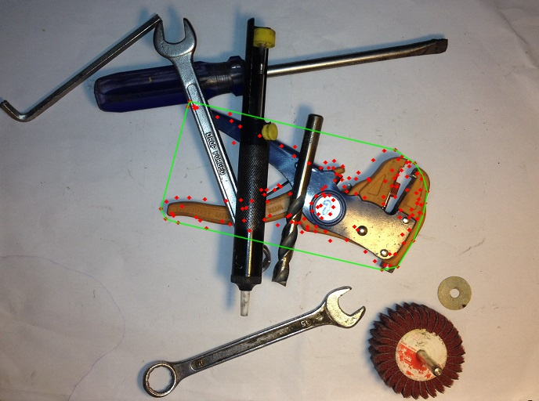
It is robust to partially occlusion and rotation

Slide 20
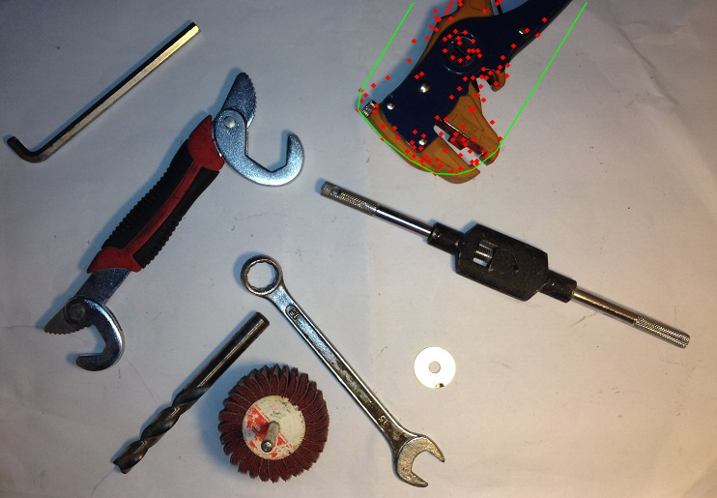
Even if some parts are invisabe
Notes:
Title results (missing part)

Slide 21


Slide 22
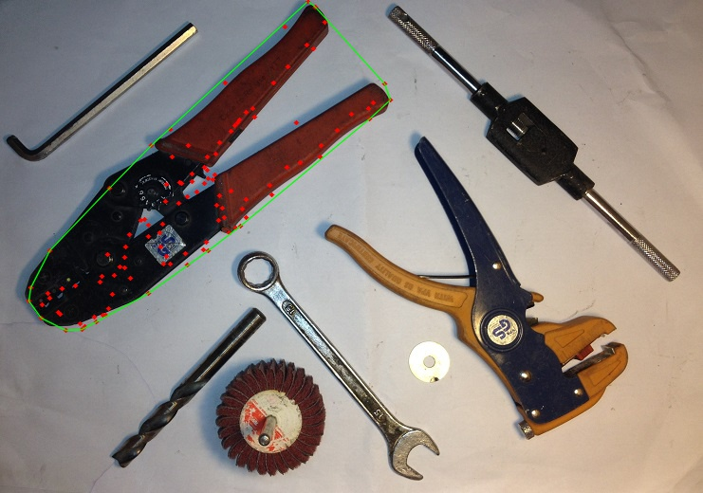

Slide 23
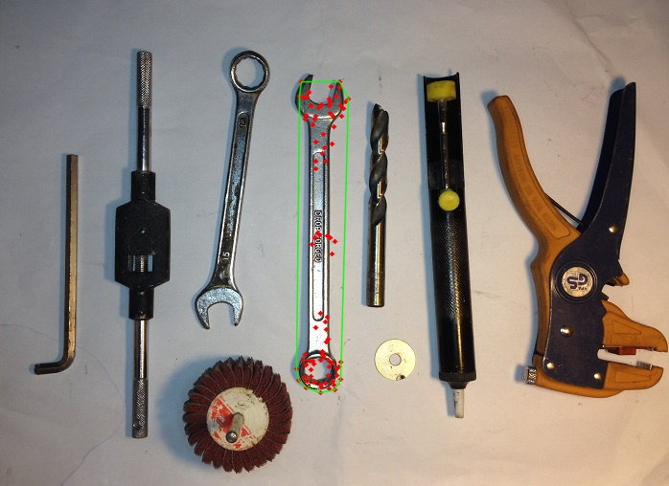

Slide 24
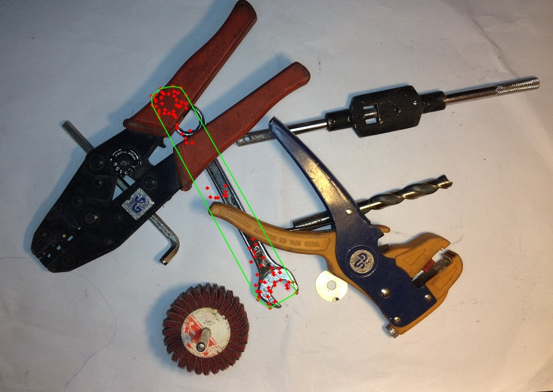

Slide 25
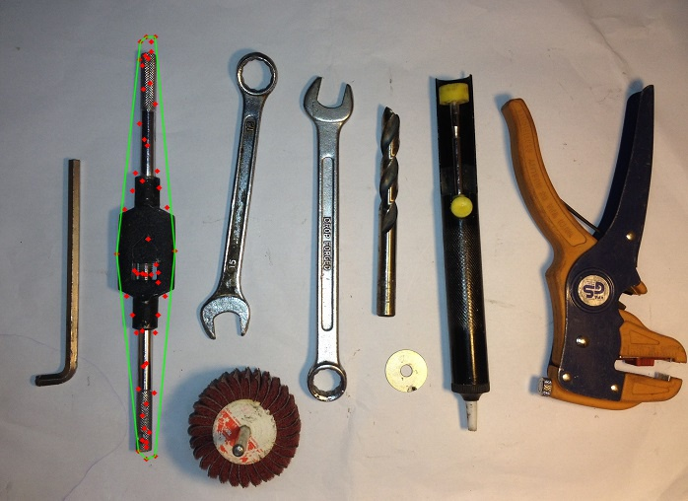
Notes:
Result (other objects)

Slide 26
I have developed an object recognition algoritm based on lsd and ght
It can handle translation rotation partial oocclusion and missing parts
It need to be extended in order to handle also scaling

